Slide 1


A Generalized PSS Architecture for Balancing Transient and Small-Signal Response
Ryan T. Elliott , Payman Arabshahi , and Daniel S. Kirschen
IEEE Transactions on Power Systems, Vol.35, No. 2, pp.1446-1456, March 2020
Athul Jose P
11867566

Slide 2

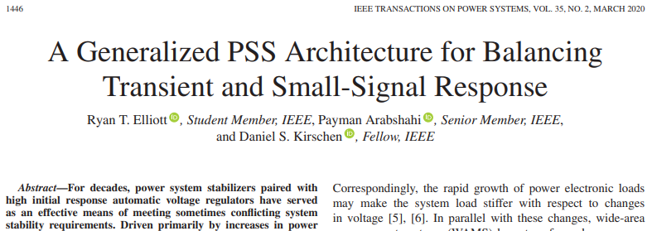
Reference Paper
WSU

Slide 3


Introduction
WSU
Exponential increase in renewable penetration
Increase in inverter based systems
Reduced system inertia and damping
Increase in voltage oscillations
Small signal and transient stability issues
System load is becoming stiffer with respect to change in voltage
Advancements in wide area monitoring systems for control purposes
R. T. Elliott, P. Arabshahi, and D. S. Kirschen, ‘‘A generalized PSS architecture for balancing transient and small-signal response,’’ IEEE Trans. Power Syst., vol. 35, no. 2, pp. 1446–1456, Mar. 2020.

Slide 4
Motivation
WSU
Renewable Energy Integration: Increasing reliance on renewable sources replaces conventional generation, impacting grid inertia, voltage support, and oscillation damping, leading to low-frequency oscillations.
Wide-Area Monitoring Systems (WAMS): Utilizing Phasor Measurement Units (PMUs) within advanced WAMS offers real-time data on grid conditions over large regions, enhancing control strategies and situational awareness to counter stability challenges.
Power System Stabilizers (PSS) and AVR Collaboration: PSS, in coordination with Automatic Voltage Regulators (AVR), improves transient stability

Slide 5
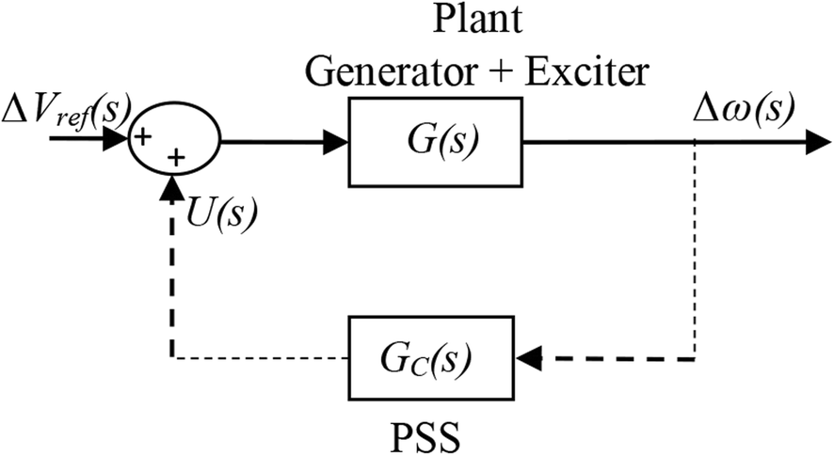
Power System Stabilizer
WSU
Synchronous generators have high gain AVRs to enhance stability margins.
High gain AVR increases synchronizing torque, however, they reduces the damping torque.
PSS produce auxiliary signals to excitation systems to reduce low frequency oscillation
Design of PSS is generally done based on fixed operating condition.
https://pcmp.springeropen.com/articles/10.1186/s41601-020-00165-9/figures/3

Slide 6
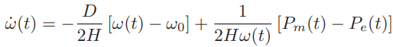
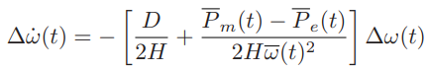
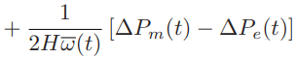
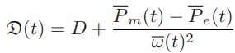
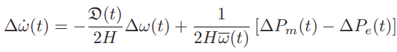
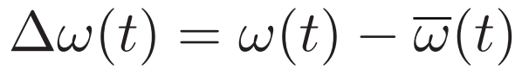
Control Strategy
WSU
Swing equation
Linearizing about a non equilibrium trajectory
function of time tracks changes in overall system operating point
R. T. Elliott, P. Arabshahi, and D. S. Kirschen, ‘‘A generalized PSS architecture for balancing transient and small-signal response,’’ IEEE Trans. Power Syst., vol. 35, no. 2, pp. 1446–1456, Mar. 2020.

Slide 7
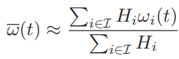
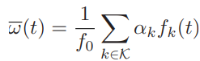
Center of Inertia Speed
WSU
COI speed is the common synchronous speed to which generators tend in steady-state conditions
COI speed calculation using weighted average of frequency measurements
R. T. Elliott, P. Arabshahi, and D. S. Kirschen, ‘‘A generalized PSS architecture for balancing transient and small-signal response,’’ IEEE Trans. Power Syst., vol. 35, no. 2, pp. 1446–1456, Mar. 2020.

Slide 8
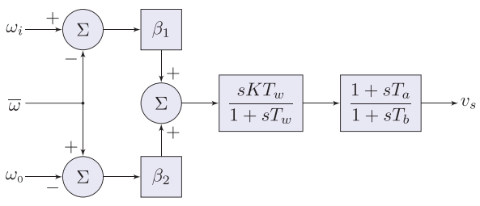
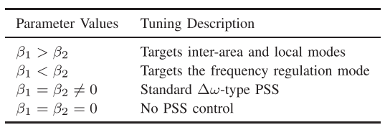
Δω-Type PSS
WSU
Output equation of PSS
R. T. Elliott, P. Arabshahi, and D. S. Kirschen, ‘‘A generalized PSS architecture for balancing transient and small-signal response,’’ IEEE Trans. Power Syst., vol. 35, no. 2, pp. 1446–1456, Mar. 2020.

Slide 9
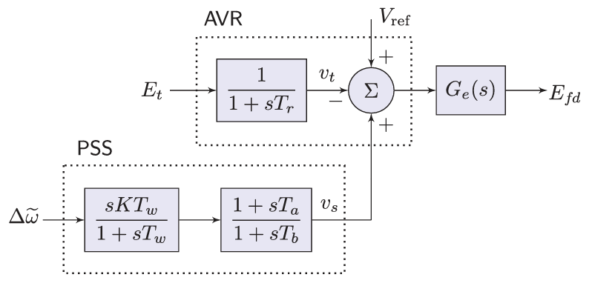
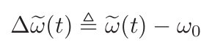
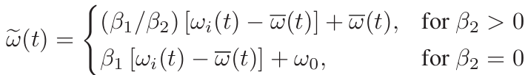
Δω-Type PSS
WSU
Control error
Feedback Signal
Key difference with other standard PSS models are use of global signal/WAMS signal for control than local signal
R. T. Elliott, P. Arabshahi, and D. S. Kirschen, ‘‘A generalized PSS architecture for balancing transient and small-signal response,’’ IEEE Trans. Power Syst., vol. 35, no. 2, pp. 1446–1456, Mar. 2020.

Slide 10
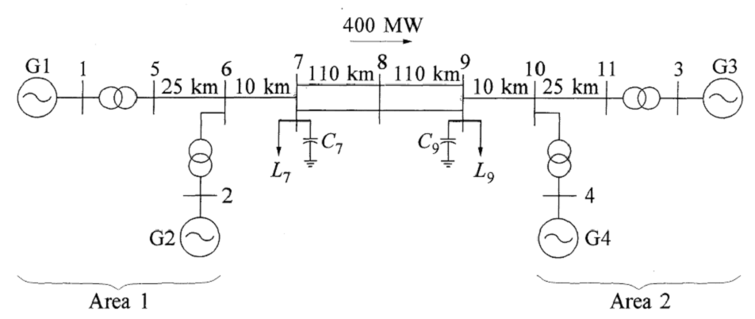
Simulation Setup
WSU
Kundur two area system with PSS on G2 and G3
R. T. Elliott, P. Arabshahi, and D. S. Kirschen, ‘‘A generalized PSS architecture for balancing transient and small-signal response,’’ IEEE Trans. Power Syst., vol. 35, no. 2, pp. 1446–1456, Mar. 2020.

Slide 11
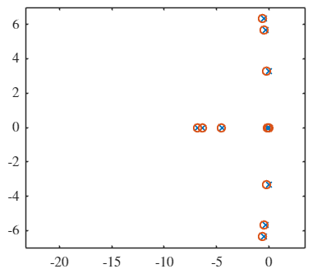
Simulation Results
WSU
Eigen Values | Frequency Mode | Damping Ratio
-100 + 0i | 0 | 1
-100 + 0i | 0 | 1
-0.60018 + 6.3558i | 1.0116 | 0.094
-0.60018 - 6.3558i | 1.0116 | 0.094
-0.45734 + 5.6573i | 0.9004 | 0.0806
-0.45734 - 5.6573i | 0.9004 | 0.0806
-6.3172 + 0i | 0 | 1
-6.827 + 0i | 0 | 1
-4.4984 + 0i | 0 | 1
-0.17707 + 3.3047i | 0.526 | 0.0535
-0.17707 - 3.3047i | 0.526 | 0.0535
-0.13455 + 0i | 0 | 1
-0.12253 + 0i | 0 | 1
-0.10255 + 0i | 0 | 1
-0.087007 + 0i | 0 | 1
-0.010801 + 0i | 0 | 1
-0.0010286 + 0i | 0 | 1
-0.0015182 + 0i | 0 | 1
-0.0033266 + 0i | 0 | 1
-0.0033331 + 0i | 0 | 1
-0.0033332 + 0i | 0 | 1
-100 + 0i | 0 | 1
Eigen Values | Frequency Mode | Damping Ratio
-0.42089 + 6.3554i | 1.0115 | 0.0661
-0.42089 - 6.3554i | 1.0115 | 0.0661
-0.28902 + 5.657i | 0.9003 | 0.051
-0.28902 - 5.657i | 0.9003 | 0.051
-6.8438 + 0i | 0 | 1
-6.3271 + 0i | 0 | 1
-4.4875 + 0i | 0 | 1
-0.011982 + 3.3021i | 0.5255 | 0.0036
-0.011982 - 3.3021i | 0.5255 | 0.0036
-0.13194 + 0i | 0 | 1
-0.10983 + 0i | 0 | 1
-0.0173 + 0i | 0 | 1
-0.0033303 + 0i | 0 | 1
-0.0033331 + 0i | 0 | 1
-0.0033332 + 0i | 0 | 1
-100 + 0i | 0 | 1
-100 + 0i | 0 | 1
-100 + 0i | 0 | 1
Eigen Value Comparison
System without PSS
System with Δω-Type PSS

Slide 12
Observations
WSU
PSS was able to improve the system dynamics by a small margin
All the frequency modes have achieved a damping greater than 5%
However, introducing PSS introduced more modes into the system.

Slide 13
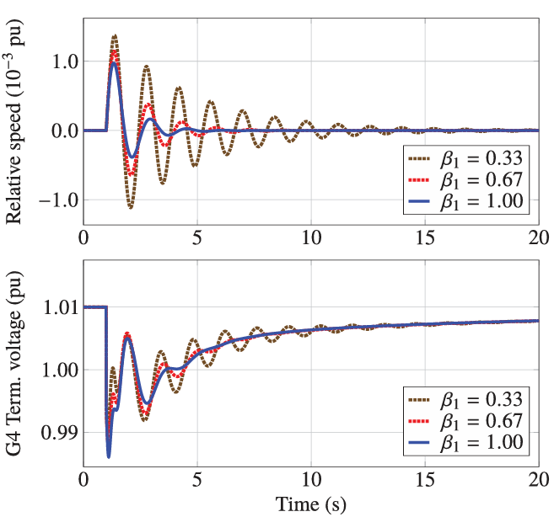
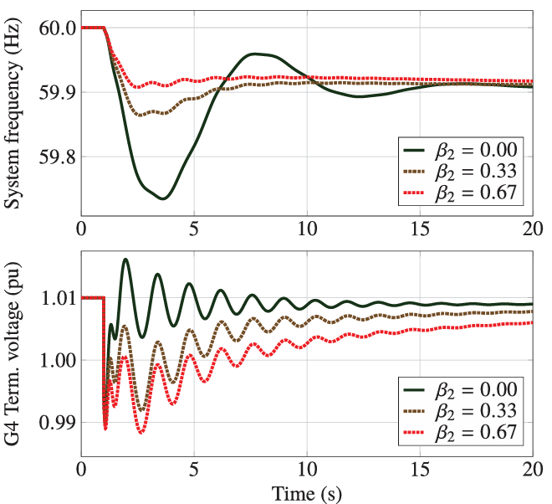
Transient Stability
WSU
Generation loss: Generator G3 tripped at 1 seconds
R. T. Elliott, P. Arabshahi, and D. S. Kirschen, ‘‘A generalized PSS architecture for balancing transient and small-signal response,’’ IEEE Trans. Power Syst., vol. 35, no. 2, pp. 1446–1456, Mar. 2020.

Slide 14


Conclusion
WSU
Generalized PSS architecture improves system response effectively in grids.
Research addresses present challenges in modern power systems effectively.
Highlights the necessity for further exploration into PSS parameter tuning.

Slide 15

WSU
Thank You
Questions?

